Slide 1

Welcome
Logipool Infotech Pvt. Ltd

Slide 2
What does Programming?
Programming is the implementation of logic to facilitate specified computing operations and functionality.
Robustness: Focuses on program continuation capability, regardless of errors or incorrect data
Reliability: Focuses on correct design and algorithm implementation
Efficiency: Focuses on memory, hardware or other properties used to optimize programs
Readability: Proper documentation and indentation availability, which provides insight to other program developers or designers

Slide 3
Operating System
An operating system (OS), in its most general sense, is software that allows a user to run other applications on a computing device.
The operating system manages a computer's hardware resources, including:
Input devices such as a keyboard and mouse
Output devices such as display monitors, printers and scanners
Network devices such as modems, routers and network connections
Storage devices such as internal and external drives

Slide 4
What does System Programming mean?
System programming involves designing and writing computer programs that allow the computer hardware to interface with the programmer and the user, leading to the effective execution of application software on the computer system.

Slide 5
Application Program
An application program is a comprehensive, self-contained program that performs a particular function directly for the user.
Email
Web browsers
Games
Word processors
Enterprise software
Accounting software
Graphics software
Media players
Database management

Slide 6
Machine language
Machine code or object code, machine language is a collection of binary digits or bits that the computer reads and interprets.
Below is an example of machine language (binary) for the text "Hello World".
01001000 01100101 01101100 01101100 01101111 00100000 01010111 01101111 01110010 01101100 01100100

Slide 7
Compiler : Compilers are used to convert high level languages (like C, C++ ) into machine code .
Assembers : Assembler are used to convert assembly language code into machine code.
Interpreter : An interpreter is a computer program which executes a statement directly (at runtime).

Slide 8
Programming Language
It allow us to give instructions to a computer in a language the computer understands. Just as many human-based languages exist, there are an array of computer programming languages that programmers can use to communicate with a computer.

Slide 9
C Programming language
a structure-oriented, middle-level programming language mostly used to develop low-level applications.
Professions and Industries
Major Organizations
Specializations and Industries Where C Language is Used Most

Slide 10
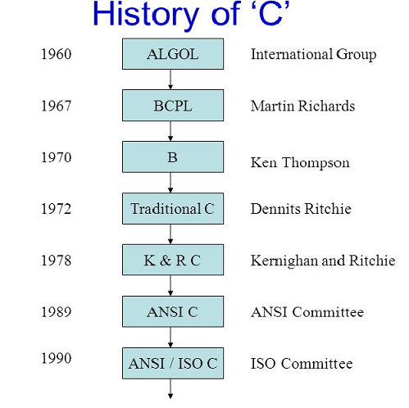

Slide 11
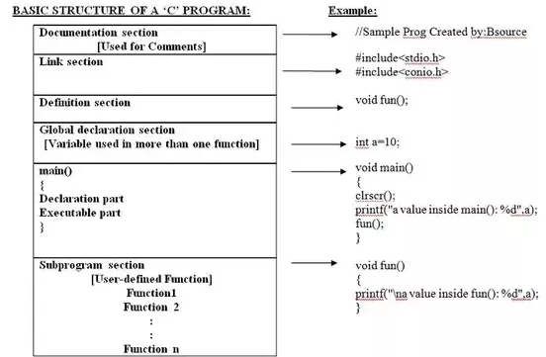
Structure of c programming

Slide 12
Documentation Section
Comment lines which include the name of the program, the name of the programmer, the author and other details like time and date of writing the program.
Example
/*Documentation Section:
Program Name: Program to find the area of circle
Author: Anuradha Raut
Date : 12/01/2013
Time : 10 AM */
OR
//Logipoll Infotech Pvt. Ltd.

Slide 13
Link Section
the header files of the functions that are used in the program. It provides instructions to the compiler to link functions from the system library such as using the #include directive.
Example
#include"stdio.h" //link section #include"conio.h" //link section

Slide 14
Definition Section
All the symbolic constants are written in the definition section. Macros are known as symbolic constants.
Example
#define PI 3.14 //definition section

Slide 15
Global Declaration Section
The global variables that can be used anywhere in the program are declared in the global declaration section. This section also declares the user defined functions.
Examples
float area; //global declaration section

Slide 16
main() Function Section
contains two parts, declaration and executable part. The declaration part declares all the variables that are used in executable part. These two parts must be written in between the opening and closing braces. Each statement in the declaration and executable part must end with a semicolon (;). The execution of the program starts at opening braces and ends at closing braces.
Declaration part:
The declaration part declares all the variables used in the executable part.
Executable part: There is at least one statement in the executable part. These two parts must appear between the opening and closing braces. The program execution begins at the opening brace and ends at the closing brace.

Slide 17
void main()
{
float r; //declaration part
printf("Enter the radius of the circle\n"); //executable part start here
scanf("%f",&r);
area=PI*r*r;
printf("Area of the circle=%f \n",area);
message();
}

Slide 18
Subprogram Section
all the user defined functions that are used to perform a specific task. These user defined functions are called in the main()function.
Example
void message()
{
printf("This Sub Function \n");
printf("we can take more Sub Function \n");
}

Slide 19
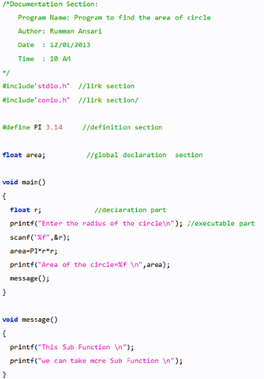

Slide 20
Thank You

